Slide 1


Data
Analysis
Notes:
Hello and welcome, my name is Mallajyosyula N Y S N Murthy and today I will be presenting to you the results of the Data Analytics task

Slide 2


Today's agenda
Project recap
Problem
The Analytics team
Process
Insights
Summary
Notes:
Today's agenda will be as follows:
1. We will recap the overall project to give a high level understanding of the business problem we're tackling and the specific requirements.
2. We will dive into the specific problem that we, the Data Analytics team, have been focusing on and will give some background as to why this is such a big problem.
3. After introducing the problem, I will go over the team responsible from our side in tackling this task.
4. I will then go over the high-level process that we followed to complete this task, so that you have complete clarity in how we tackle these kinds of tasks.
5. Finally, I will go over the all important results and I will present them as a series of insights and visualizatio's from our analysis.
To wrap up, I will summarize and open for any questions.

Slide 3

Social Buzz is a fast growing technology unicorn that need to adapt quickly to it's global scale. Accenture has begun a 3 month POC focusing on these tasks:
An audit of Social Buzz's big data practice
Recommendations for a successful IPO
Analysis to find Social Buzz's top 5 most popular categories of content
Project Recap

Slide 4

Problem

Slide 5



Mallajyosyula N Y S N Murthy
RF Engineer
The Analytics team
MARCUS ROMPTON
Senior Principal
ANDREW FLEMING
Chief Technology Architect

Slide 6
Process
1
Data Understanding
2
Data Cleaning
3
Data Modelling
4
Data Analysis
5
Uncover Insights
Notes:
Well we approached it in 5 steps:
1. Data understanding - the key to success on any data project is to understand the data in detail. So we took the time to understand the data model and domain of your business.
2. Data cleaning - after understanding your business, we then cleaned the available datasets and thought about what an ideal dataset should look like for this problem.
3. Data modelling - After ensuring the data was clean for analysis, we needed to process and model this data into a dataset that can precisely answer the business questions and produce the results needed.
4. Data analysis - With our new dataset, we used our analytical expertise to uncover insights from this dataset and to produce visualizations to describe the insights.
5. And finally we used these insights to unlock business decisions and to make recommendations on next steps.

Slide 7

Insights
16
1897
JANUARY
UNIQUE
CATEGORIES
REACTIONS TO "ANIMAL" POSTS
MONTH WITH
MOST POSTS
Notes:
From your data we found that you had a total of 16 unique categories of posts across your sample dataset. This includes things such as Food, Culture and Sport.
As well as this, there were 1897 reactions from just the animal category alone! People obviously really like animals!
And also the most common month for users to post within was January. This aligns with seasonal trends of social media users that feel the need to reconnect with people after calendar events such as Christmas.
But now, onto the main question... which is... what were the top 5 most popular categories of posts?

Slide 8
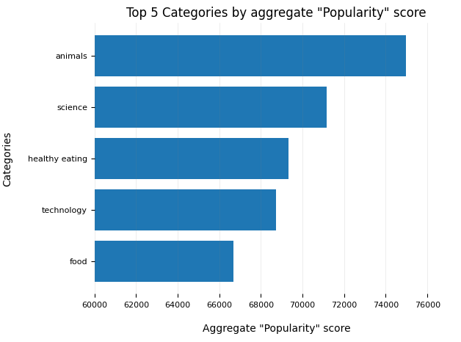
Notes:
From our analysis, you can see that the top 5 most popular categories of posts were animals, science, healthy eating, technology and food in descending order.
Animals had an aggregate popularity score of around 74965. It is very interesting to see both food and healthy eating within the top 5, it really shows that food is a highly engaging content category. Healthy eating ranks slightly higher than food, so perhaps your user base may be skewed towards healthy eaters and health-conscious people.
Finally, its also interesting to see science and technology too. This may suggest that people enjoy consuming factual content and snippets of content that they can learn something from.

Slide 9
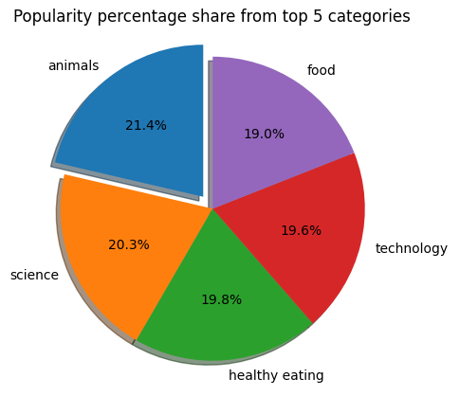
Notes:
Additionally, you can see from this chart the % split of popularity between the top 5 categories. There is not much difference between the share of each category, however, the difference between the 1st most popular, animals and the 2nd most popular, science, is the largest gap equal to 1.1%.
In business terms, this could suggest that the most popular category, animals, is tailing away from the rest of the categories and may continue to get more and more popular. To avoid an issue where 1 content category consumes the entire platform, it will be important for you to ensure that any algorithms used to govern the content on the platform gives a fair balance to the content categories.

Slide 10

Summary

Slide 11

Thank you!
ANY QUESTIONS?

